Slide 1

AiTU • nov. 20, 2020
AiTU • nov. 20, 2020
AiTU • nov. 20, 2020
PERSONAL DIET SERVICE DB
Creating a database in SQL
Kadyrbergenova Nuraiym SE-2001

Slide 2
AiTU • nov. 20, 2020
- The importance of the subject
- Goal
- Tasks
- Data obtaining
- Methodology
- Future improvements
Outline

Slide 3
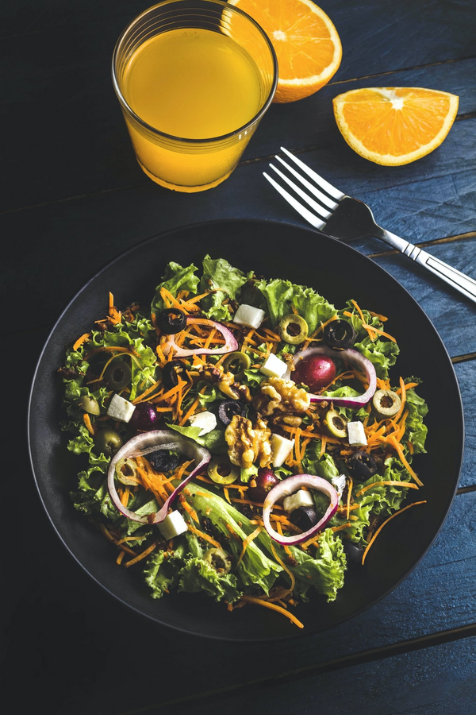
The Importance of the subject
Eating overall is crucial for living. But unhealthy diet leads to many
health problems which affect people’s everyday life. According to ‘Healthy Diet’
article from World Health Organization (2020), bad eating habits are the main
cause of health issues nowadays. Not getting enough nutrients weakens the immune
system of a person and they become more vulnerable to conditions and illnesses
including heart disease, cancer, depression, etc. (World Health Organization, 2003).
AiTU • nov. 20, 2020

Slide 4
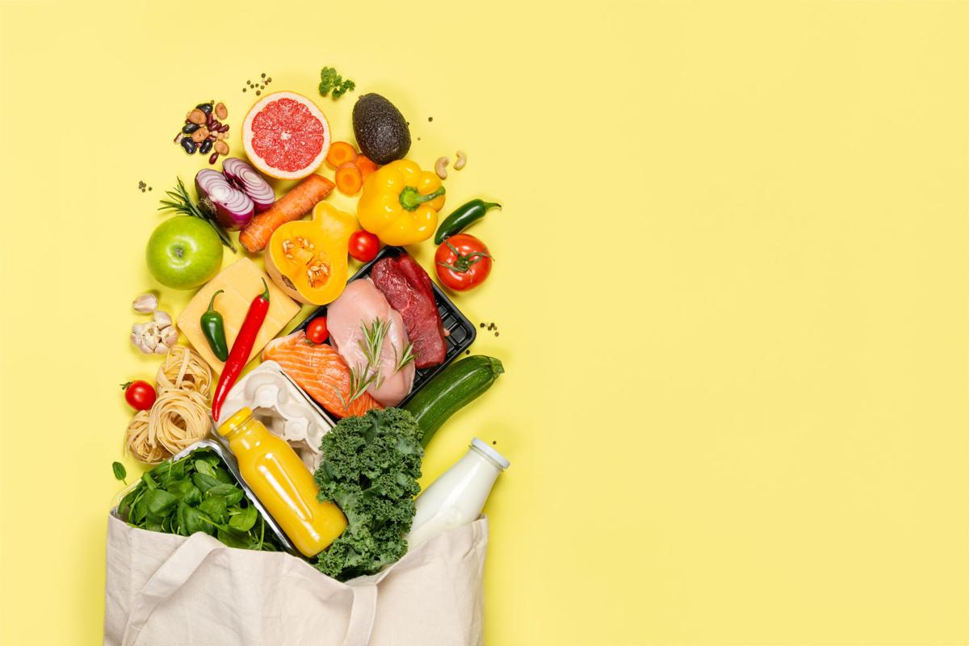
goal
Create a database that can help clients to pick a suiting diet plan according to their needs, goals, preferences and characteristics
AiTU • nov. 20, 2020

Slide 5
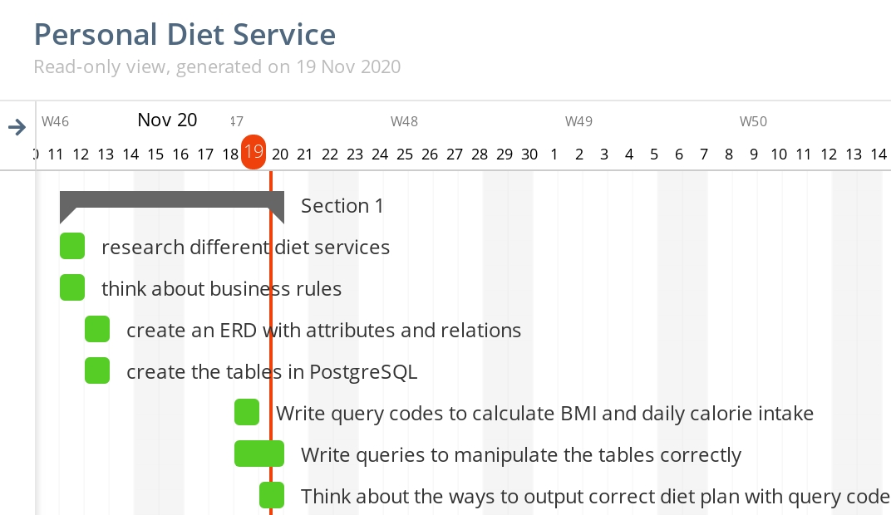
AiTU • nov. 20, 2020
Tasks
1. CREATE AN ERD
2. FIND ALGORITHMS TO CALCULATE DAILY CALORIE INTAKE
3. WRITE QUIERIES TO MANIPULATE THE DB AND OUTPUT REQUIRED DATA

Slide 6
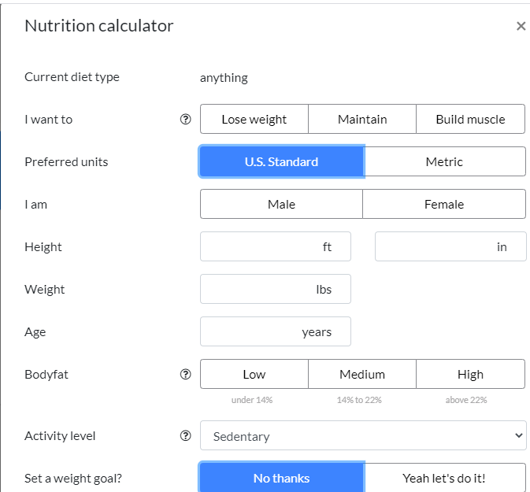
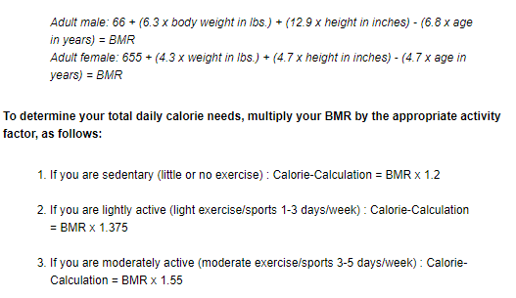
AiTU • nov. 20, 2020
ERD
Check different services to determine what information do they require.
https://www.eatthismuch.com/
Data obtaining
CALORIE CALCULATIONS
Find suiting formulas for different characteristics
http://www.checkyourhealth.org/eat-healthy/cal_calculator.php

Slide 7
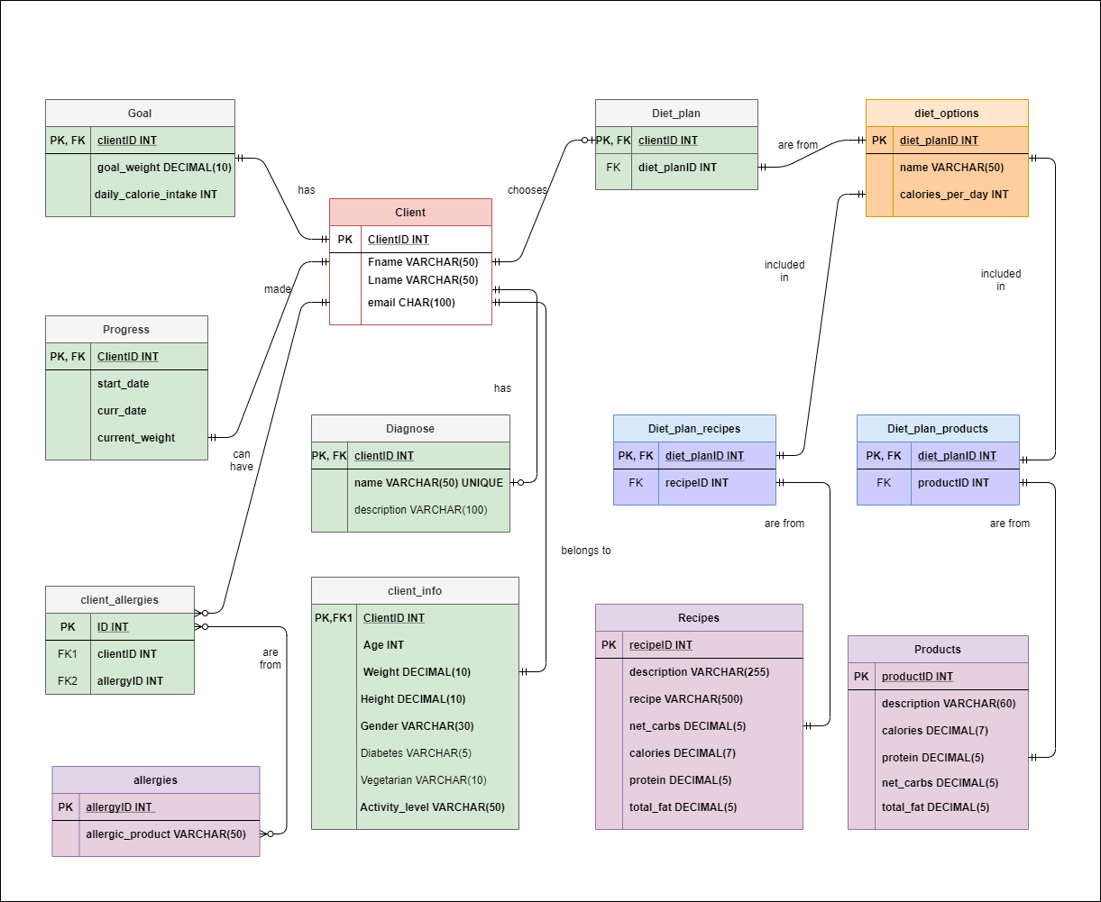
AiTU • nov. 20, 2020
Methodology
ERD

Slide 8
Query for DCI calculations
UPDATE goal SET daily_calorie_intake = CASE
WHEN gender='Female' THEN CASE
WHEN goal_weight<current_weight --if the goal is to lose weight THEN CASE
When activity_level = 'Low' THEN round((10*current_weight + 6.25*height - 5*age - 161)*1.2 - 500, -2)
When activity_level = 'Medium' THEN round((10*current_weight + 6.25*height - 5*age - 161)*1.375 - 500, -2)
When activity_level = 'High' THEN round((10*current_weight + 6.25*height - 5*age - 161)*1.55 - 500, -2)
end
When goal_weight>current_weight THEN CASE
When activity_level = 'Low' THEN round((10*current_weight + 6.25*height - 5*age - 161)*1.2 + 500, -2)
When activity_level = 'Medium' THEN round((10*current_weight + 6.25*height - 5*age - 161)*1.375 + 500, -2)
When activity_level = 'High' THEN round((10*current_weight + 6.25*height - 5*age - 161)*1.55 + 500, -2)
end end
WHEN gender='Male' THEN CASE
WHEN goal_weight<current_weight THEN CASE
When activity_level = 'Low' THEN round((10*current_weight + 6.25*height - 5*age - 5)*1.2 - 500, -2)
When activity_level = 'Medium' THEN round((10*current_weight + 6.25*height - 5*age - 5)*1.375 - 500, -2)
When activity_level = 'High' THEN round((10*current_weight + 6.25*height - 5*age - 5)*1.55 - 500, -2)
end
When goal_weight>current_weight THEN CASE
When activity_level = 'Low' THEN round((10*current_weight + 6.25*height - 5*age - 5)*1.2 + 500, -2)
When activity_level = 'Medium' THEN round((10*current_weight + 6.25*height - 5*age - 5)*1.375 + 500, -2)
When activity_level = 'High' THEN round((10*current_weight + 6.25*height - 5*age - 5)*1.55 + 500, -2)
end end
END
FROM client_info, progress where goal.clientid=client_info.clientid and progress.clientid=goal.clientid;
AiTU • nov. 20, 2020

Slide 9
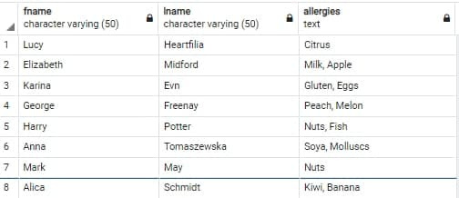

AiTU • nov. 20, 2020
ALL ALLERGIES OF CLIENTS IN 1 ROW
Queries for manipulations
SELECT fname, lname, STRING_AGG(allergic_product, ', ') AS allergies FROM
client_allergies INNER JOIN
client ON client.clientid=client_allergies.clientid
INNER JOIN
allergies ON allergies.allergyid=client_allergies.allergyid
GROUP BY fname, lname;on tools.
SHOWS CLIENTS WITH THE LOWEST BMI AND THEIR DIAGNOSIS
SELECT fname, lname, bmi, height, weight, diagnose.description FROM client_info INNER JOIN
client on client.clientid = client_info.clientid
INNER JOIN
diagnose on diagnose.clientid=client_info.clientid
WHERE bmi= (select min(bmi) from client_info);

Slide 10
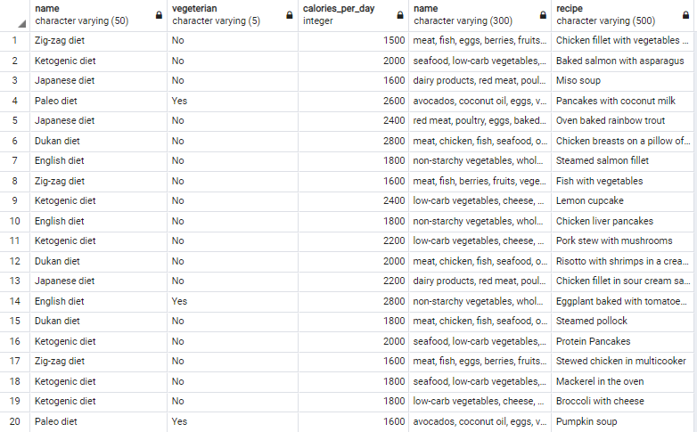
AiTU • nov. 20, 2020
Queries for manipulations
DIET PLAN DESCRIPTIONS
SELECT diet_options.name, vegeterian, calories_per_day, products.name, recipes.recipe FROM diet_options INNER JOIN diet_plan_products ON diet_plan_products.diet_planid=diet_options.diet_planid
INNER JOIN diet_plan_recipes ON diet_plan_recipes.diet_planid=diet_options.diet_planid
INNER JOIN products ON products.productid=diet_plan_products.productid INNER JOIN recipes ON recipes.recipeid=diet_plan_recipes.recipeid;

Slide 11
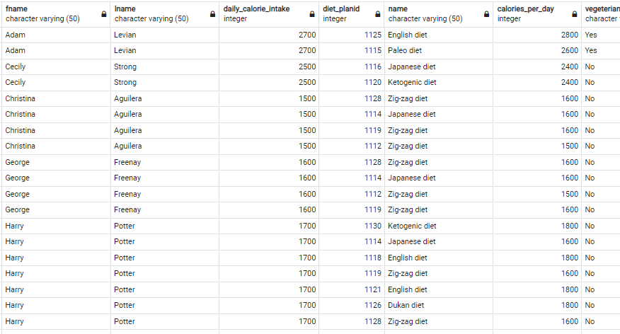
AiTU • nov. 20, 2020
SHOWS EVERY DIET PLAN A CLIENT CAN CHOOSE FROM
Queries for manipulations
SELECT
fname, lname, goal.daily_calorie_intake, diet_options.* FROM diet_options, client INNER JOIN
client_info ON client_info.clientid=client.clientid INNER JOIN
goal ON client_info.clientid=goal.clientid WHERE
diet_options.calories_per_day>goal.daily_calorie_intake-200 AND
diet_options.calories_per_day<goal.daily_calorie_intake+200
AND diet_options.vegeterian=client_info.vegeterian
ORDER BY fname, lname;

Slide 12
AiTU • nov. 20, 2020
Adding triggers and functions for flexibility and up-to-date calculations
Adding more choices of diet plans(gluten-free, lactose free, vegan)
Possible Future Improvements
Add water and nutritions calculator

Slide 13
Thank you for your attention!

Slide 14
Healthy diet. (2020). World Health Organization. https://www.who.int/news-room/fact-sheets/detail/healthy-diet
World Health Organization. (2003). Diet, nutrition and the prevention of chronic diseases: report of a Joint WHO/FAO Expert Consultation (No. 916). http://158.232.12.119/nutrition/publications/obesity/WHO_TRS_916/en/

